Slide 1

Full Stack Development with Java(ID-202B) Even Semester Session 2024-25 DIGITAL DETOX
Group Members:
Gulshan Kumari : 202410116100078
Divyam Raj : 202410116100066
Divakar Verma : 202410116100065
Project Supervisor:
Ms. Shruti Aggarwal
Assistant Professor

Slide 2
Content
Introduction
Literature Review
Objective of the Project
Technology
Hardware Requirements
Software Requirements
Modules
Workflow
Reports
Conclusion

Slide 3
Introduction
In today's world, the need for environmental sustainability and proper waste management is more crucial than ever. Digital Detox is an innovative e-commerce platform designed to help users recycle their old products and easily buy new or second-hand items.
The primary objective of this platform is to reduce waste by encouraging people to trade in their used products, which can either be recycled or refurbished for resale.

Slide 4
Literature Review
The development of platforms promoting reuse, recycling, and refurbishment aims to reduce waste and foster a circular economy. E-commerce platforms are being designed to minimize environmental impact and encourage sustainable consumption.
According to a study by United Nations Environment Programme (UNEP), global waste production has increased significantly, causing pollution, climate change, and resource depletion. Digital Detox offers an e-commerce platform for trading old products and buying refurbished items, reducing environmental impact.
The World Economic Forum emphasizes the circular economy's role in reducing waste by promoting product refurbishment and reuse. Digital Detox supports this by creating a marketplace for upcycled products, encouraging sustainable consumption.
Furthermore, a report by Statista (2023) shows that E-waste has become a significant global issue, with millions of tons discarded annually. Platforms like OLX and Digital Detox encourage recycling and purchasing refurbished items to reduce waste and promote eco-friendly practices.

Slide 5
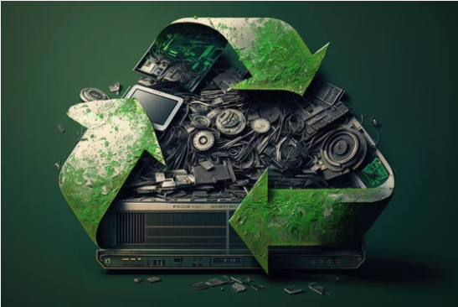
Objective of the Project
The main objective of the Digital Detox project is to create an e-commerce platform that promotes waste reduction, recycling, and responsible consumption by encouraging users to sell, recycle, or buy second-hand or refurbished products.

Slide 6
Technology (Hardware Requirements)
Development Environment:
Personal Computers/Laptops
Minimum specifications
Processor: Intel i5 or equivalent
RAM: 8 GB or more
Storage: 256 GB SSD or higher
Client Requirements :
Personal Computers/Laptops
Minimum specifications
Processor: Intel i5 or equivalent
RAM: 8 GB or more
Storage: 256 GB SSD or higher

Slide 7
Technology (Software Requirements)
Frontend Technologies:
HTML/CSS: For structuring and styling the web pages.
JavaScript: To create interactive elements on the platform.
React.js: A JavaScript library for building user interfaces, providing a dynamic and responsive experience.
Backend Technologies:
Node.js: A JavaScript runtime for building server-side applications, allowing for efficient handling of requests.
Express.js: A web application framework for Node.js to simplify routing and middleware management.
MongoDB: A NoSQL database for storing product listings, user data, and transaction records, enabling flexible data management.

Slide 8
Modules
User Authentication Module : Handles user registration, login, password recovery, and profile management.
Product Management Module : Allows users to list, view, edit, and delete products for sale or recycling.
Recycling Management Module : Manages the recycling process, including scheduling pickups, tracking recycled items, and providing information on recycling procedures.
Payment Processing Module : Integrates secure payment gateways to handle transactions, refunds, and credit system for users.
Admin Panel Module : Enables administrators to manage users, products, transactions, and monitor recycling operations.

Slide 9
Workflow/Gantt Chart
1
3
5
Request Handling
Admin Dashboard
E-Waste Disposal
2
4
6
User Interaction
Data Storage & Management
Real-Time Updates

Slide 10
Reports
Sales Report : The sales report indicates a steady increase in revenue, with strong performance from both new and upcycled products, reflecting growing consumer interest in sustainable purchasing.
Customer Report : The customer report shows a rise in registered users, with an increasing number of active participants engaging in recycling and purchasing, demonstrating the platform's effectiveness in promoting eco-friendly practices.
Inventory Report : The inventory report highlights a healthy stock of both new and upcycled products, ensuring availability for customer demand while supporting the platform's commitment to sustainability.

Slide 11
Conclusion
In conclusion, Digital Detox represents a crucial step towards environmental sustainability by leveraging e-commerce to promote recycling and reuse. By facilitating the trade-in of used items for recycling or refurbishment, this platform reduces waste and fosters sustainable consumption. Digital Detox sets a precedent for how technology can protect the planet.

